Slide 1
Design and Analysis of Algorithm
UNIT-III
Dynamic Programming
M Yogi Reddy
Assistant Professor,
Dept. of CSE,
School Of Technology,
GITAM(Deemed to be ) University,
Hyderabad.

Slide 2

Dynamic Programming Applications
Multistage graphs
All pairs shortest paths
Optimal binary search trees
Reliability design
Travelling sales person problem

Slide 3
All Pairs Shortest Paths (APSP)
► All edge weights are nonnegative : use Dijkstra’s algorithm
► Negative edge weights : use Bellman-Ford algorithm

Slide 4
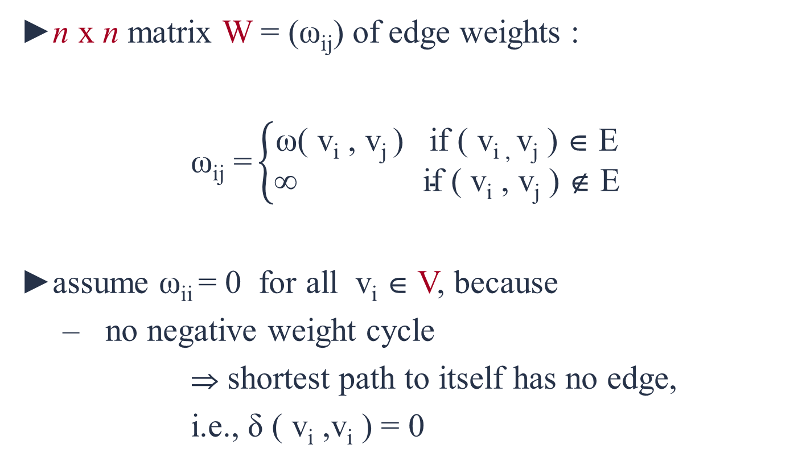
Adjacency Matrix Representation of Graphs
►n x n matrix W = (ω_{ij}) of edge weights :
$\text{ω}\text{ij}\text{ =}\left\{\begin{matrix}\text{ω}\text{(} \text{v}\text{i} \text{, }\text{v}\text{j} \text{) }\text{if}\text{ (} \text{v}\text{i}\text{ , }\text{v}\text{j}\text{ ) }\text{∈} \text{E} \\ \text{∞ }\text{if}\text{ (} \text{v}\text{i}\text{ , }\text{v}\text{j} \text{) }\text{∉} \text{E} \end{matrix}\right.$
►assume ω_{ii} = 0 for all v_{i} ∈ V, because
no negative weight cycle
⇒ shortest path to itself has no edge,
i.e., δ ( v_{i} ,v_{i} ) = 0

Slide 5
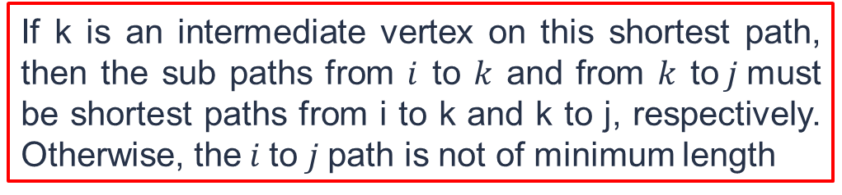
Floyd Warshall Algorithm
We examine a shortest path $i$ to $j$ in G. This path originates at vertex $i$ and goes through some intermediate vertices (possibly none) and terminates at vertex $j$.
If k is an intermediate vertex on this shortest path, then the sub paths from $i$ to $k$ and from $k$ to$j$must be shortest paths from i to k and k to j, respectively. Otherwise, the$i$to $j$path is not of minimum length

Slide 6
Steps to find all pair shortest path
Remove all the self loops and parallel edges (keeping the lowest weight edge) from the graph.
Write the initial distance matrix.
For diagonal elements (representing self-loops), distance value = $0$
For diagonal elements (representing self-loops), distance value = 0
For vertices having a direct edge between them, distance value = weight of that edge.
For vertices having no direct edge between them, distance value = $∞$.
For vertices having no direct edge between them, distance value = ∞.

Slide 7
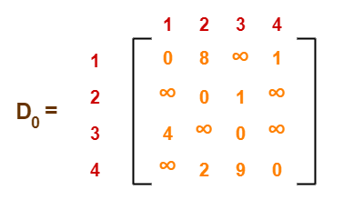
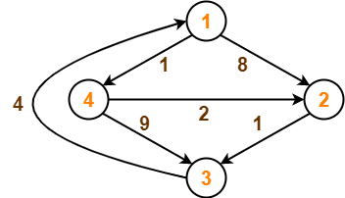
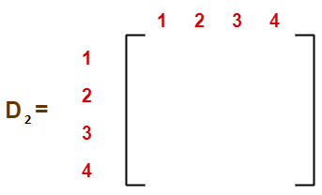
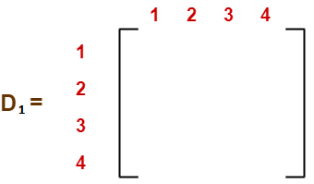
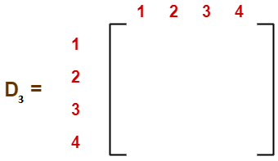




































Example
Initial distance matrix
0
8
$$9$$
1
$$∞$$
0
1
$$∞$$
4
$12$
0
$$5$$
$$∞$$
$$2$$
$$3$$
$$0$$
0
8
$$∞$$
1
0
8
$$9$$
1
0
3
$$4$$
1
$$∞$$
0
1
$$∞$$
$$5$$
0
1
$$6$$
$$5$$
0
1
$$6$$
4
$12$
0
5
4
$12$
0
$$5$$
4
$$7$$
0
$$5$$
$$∞$$
$$2$$
$$9$$
$$0$$
$$7$$
$$2$$
$$0$$
$$7$$
$$2$$
$$0$$
$$3$$
$$3$$
D4 gives the shortest path between each pair of vertices.

Slide 8
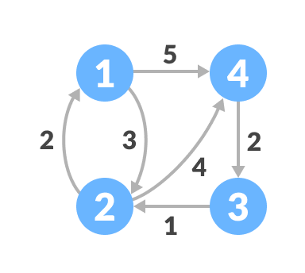
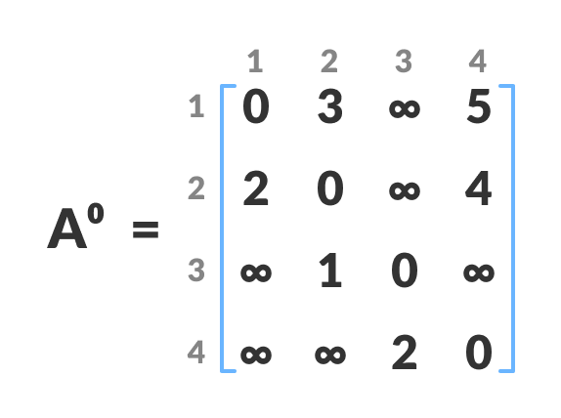
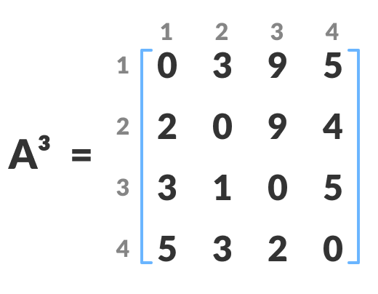
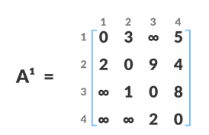
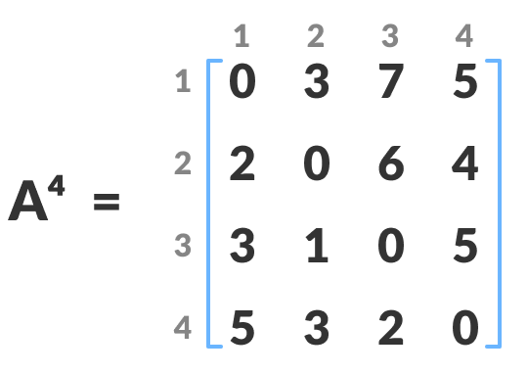
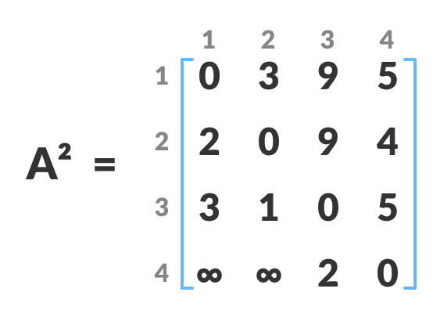
Example
A4 gives the shortest path between each pair of vertices.

Slide 9
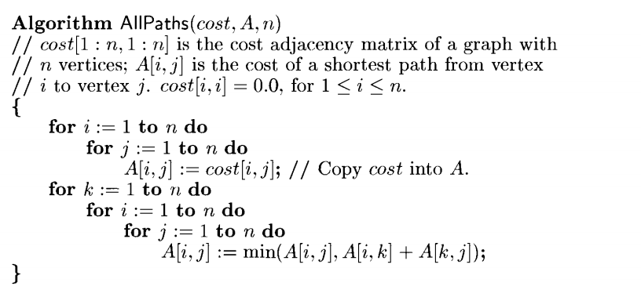
Floyd Warshall Algorithm
Complexity of Floyd Warshall algorithm is O(n³).

Slide 10



